Slide 1
ELAC
English Learner Advisory Committee
Academic Counselor: Ms. Patricia Murillo
Principal for JSHS: Ms. Leslie Marley
Principal for CMS: Mr. Steve Peters

Slide 2
¿What is ELAC?
Parents of EL students
Purpose: For parents to advise the school’s administration about programs and services for students
Opportunity for parents to receive advice and information on how to support their EL student

Slide 3
JSHS Staff - Administration
Principal: Leslie Marley Vice Principal: Allen Boltz

Slide 4
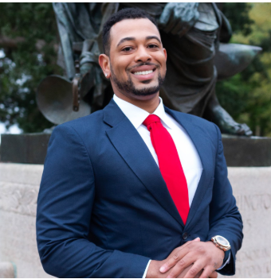
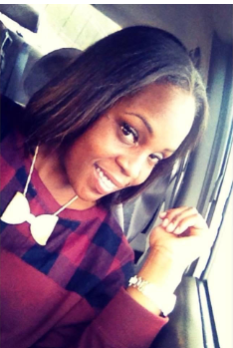
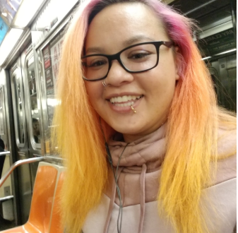
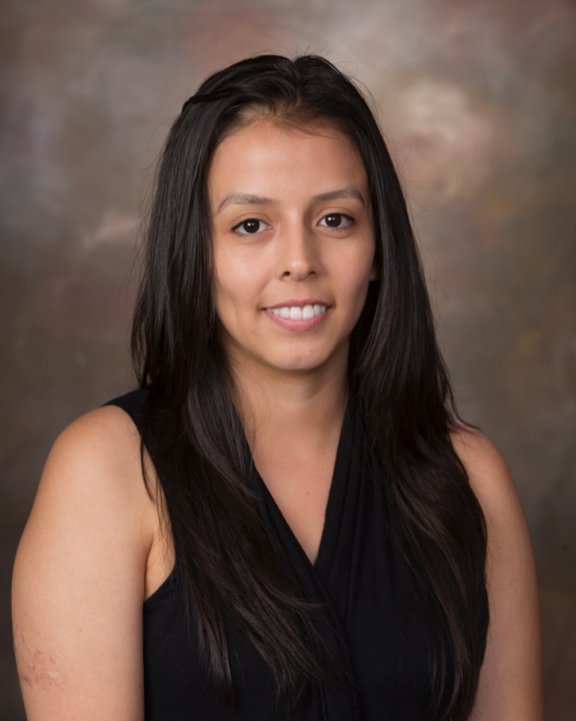
JSHS Staff - Counselors
Mental Health Academic Counselor
Wiley Rogers Tayari Carte Fidelia Ionyejekwe Kimchi Brooks Patricia Murillo

Slide 5
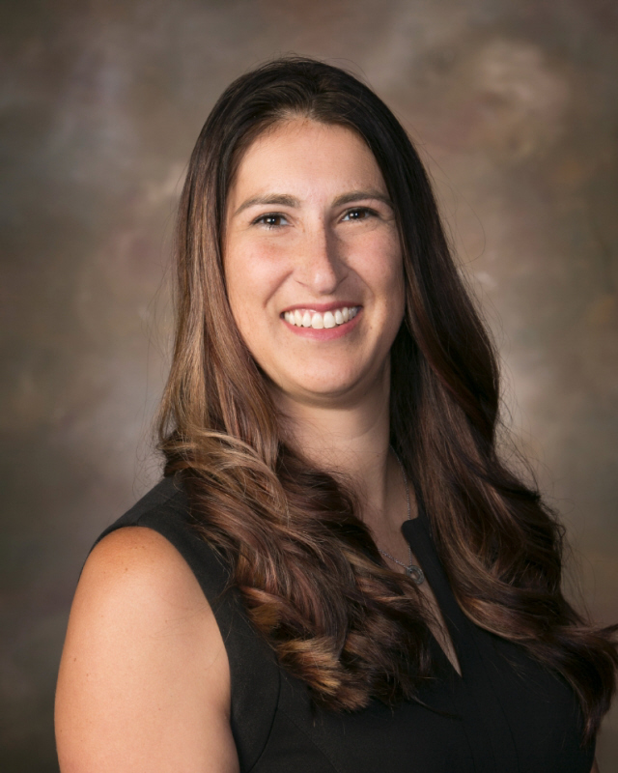
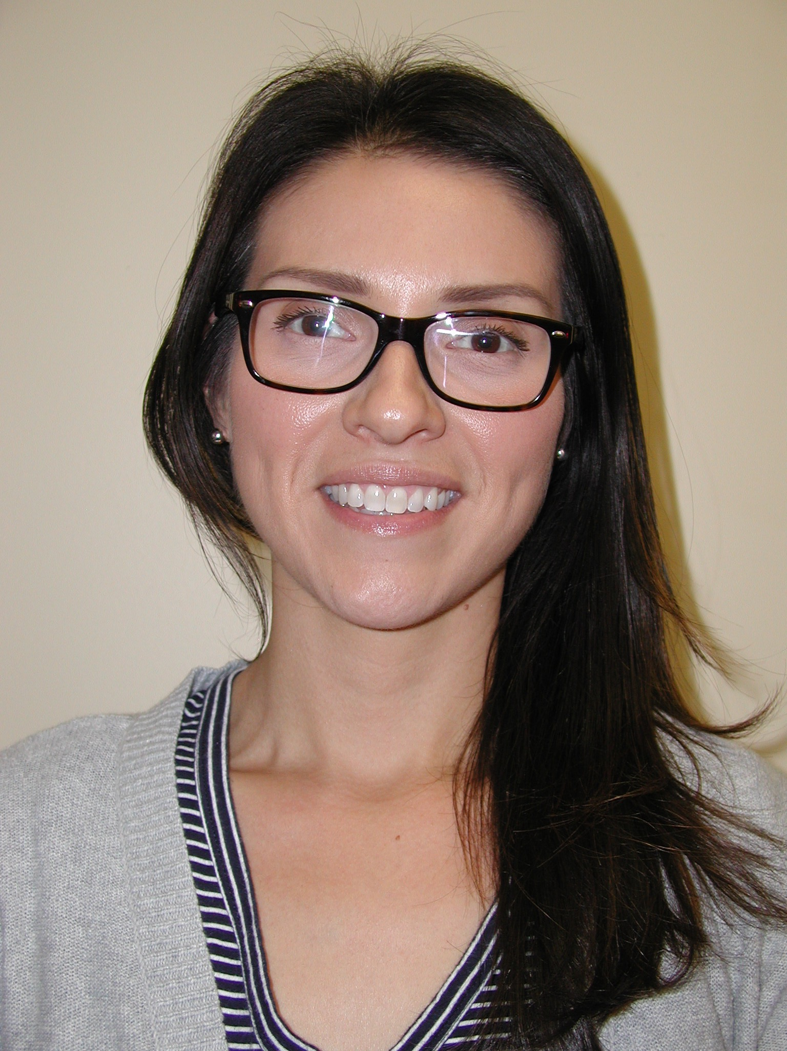
JSHS Staff - Office
Registrar: Attendance: ELD Teacher:
Erica Schlepp Celina Castillo Samuel Davis

Slide 6
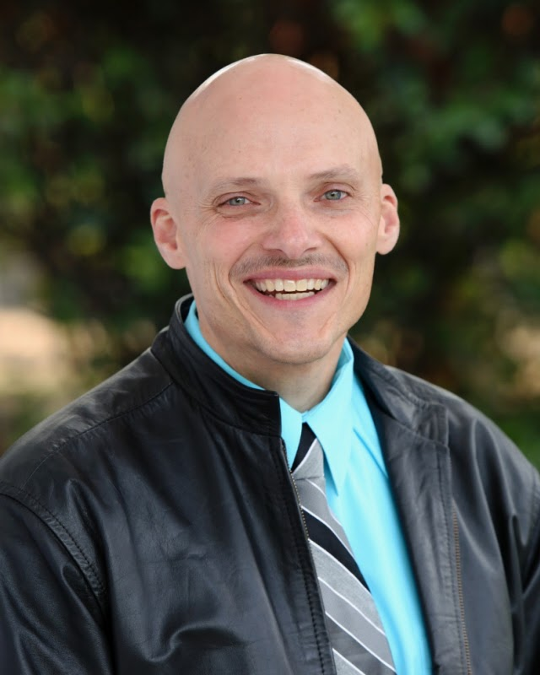
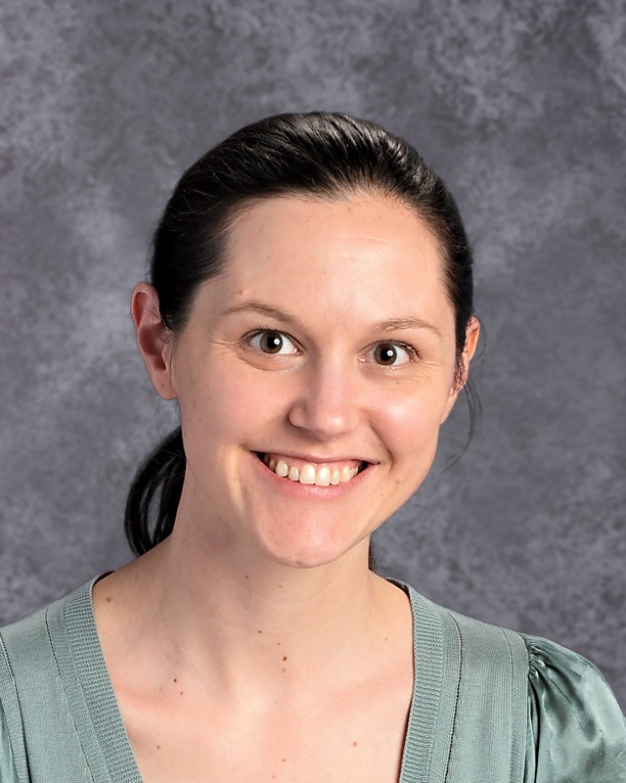
CMS Staff
Steve Peters Eden Kennedy-Hoffmann
Principal Teacher on Special Assignment

Slide 7
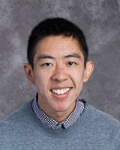
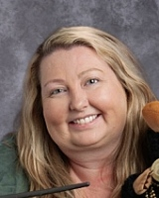
CMS Staff
Mental Health Counselors
Johnny Fang Kasey Wallace Angela Mendoza Ben Buckner

Slide 8
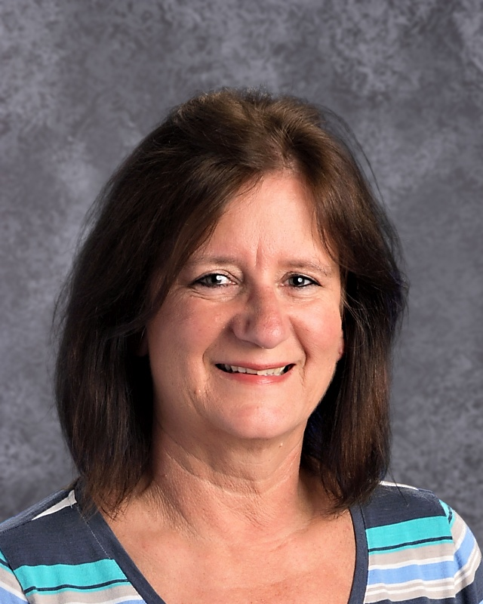
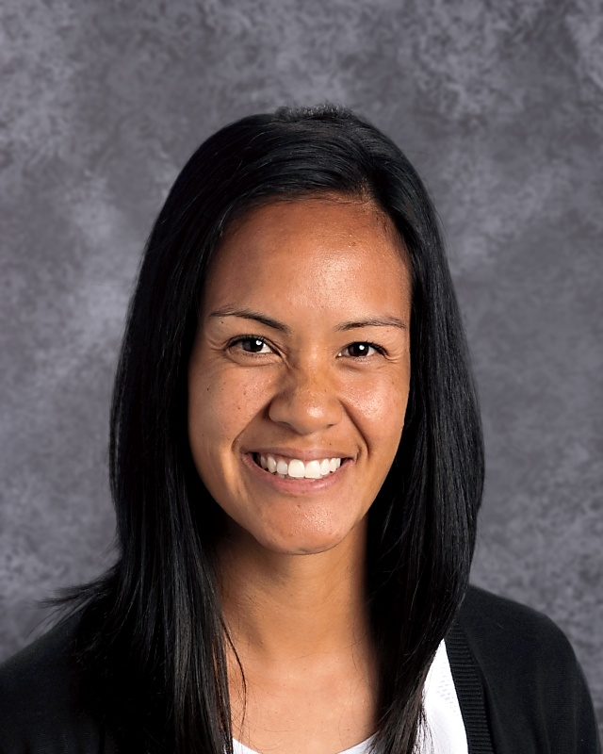
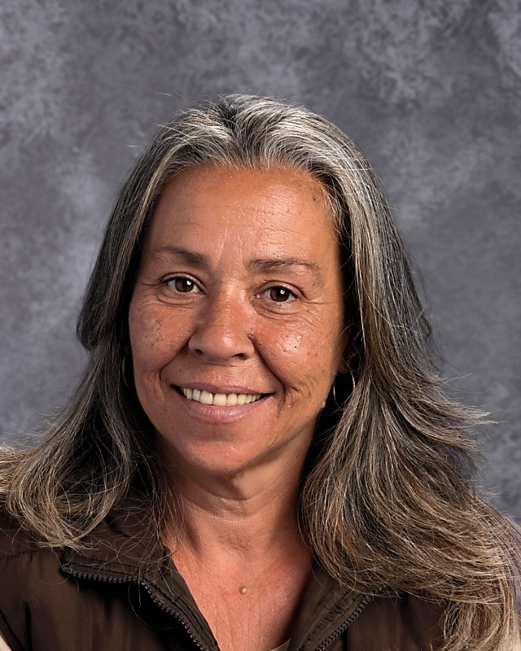
CMS Staff
Office:
Registrar: Attendance: ELD Teacher Bilingual Support
Annie Miller Rhaylynn Taniguchi Marilou Bibat Maria Ayala

Slide 9
Attendance - Its importance
Valid reasons to miss classes
Doctor appointment (call the school) - not for the whole day
Sickness
Death
Other emergencies
Reasons that are not so good:
Translation
To watch a sports game
Babysit
Other
Distance Learning (attendance)
Live classes
Non-live classes

Slide 10
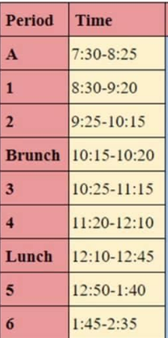
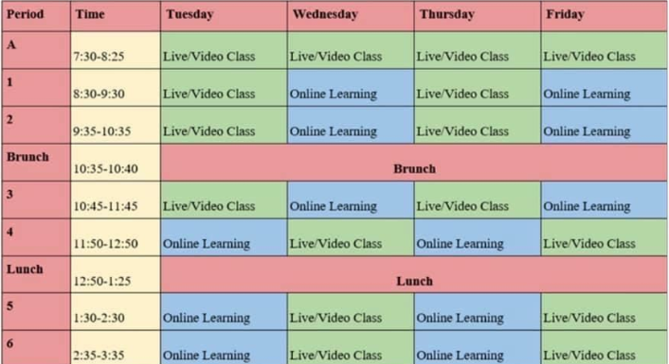
Distance Learning 2020 - JSHS
Google Classroom
Schedule available:
Monday schedule: Live check-in with 2nd period only. Attendance for all other classes are through Google Classroom

Slide 11
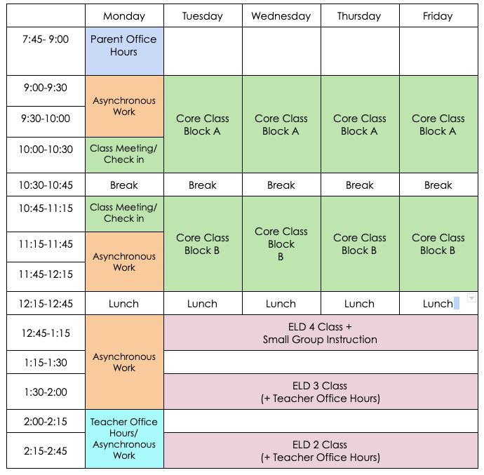
Distance Learning 2020 - CMS
There are 3 levels of ELD classes, which meet Tuesday-Thursday
ELD 3/4- 12:45-1:15
ELD 3 - 1:30-2:00
ELD 2/3 - 2:15-2:45
Teacher office hours, small group instruction, and asynchronous work also takes place after lunch

Slide 12
Communication
Concerns regarding :
Your child’s grade?
Mental health?
Graduation?
Behavior? Discipline?
How can you communicate?
Email, phone, text

Slide 13
Aeries
Attendance
Grades
Missing assignments
Help with creating your Aeries account

Slide 14
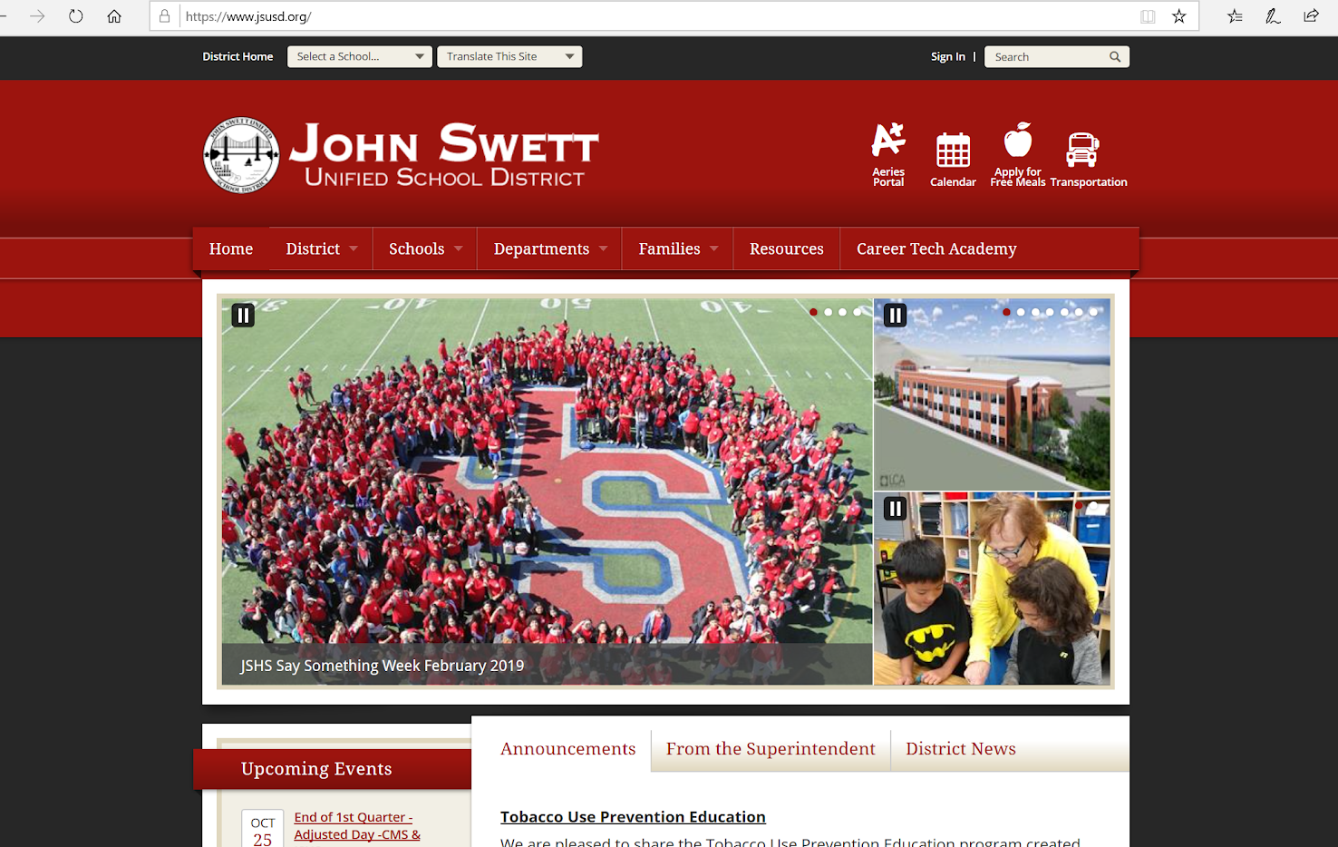
Aeries
Help with creating your Aeries account

Slide 15
Aeries
Help with creating your Aeries account

Slide 16
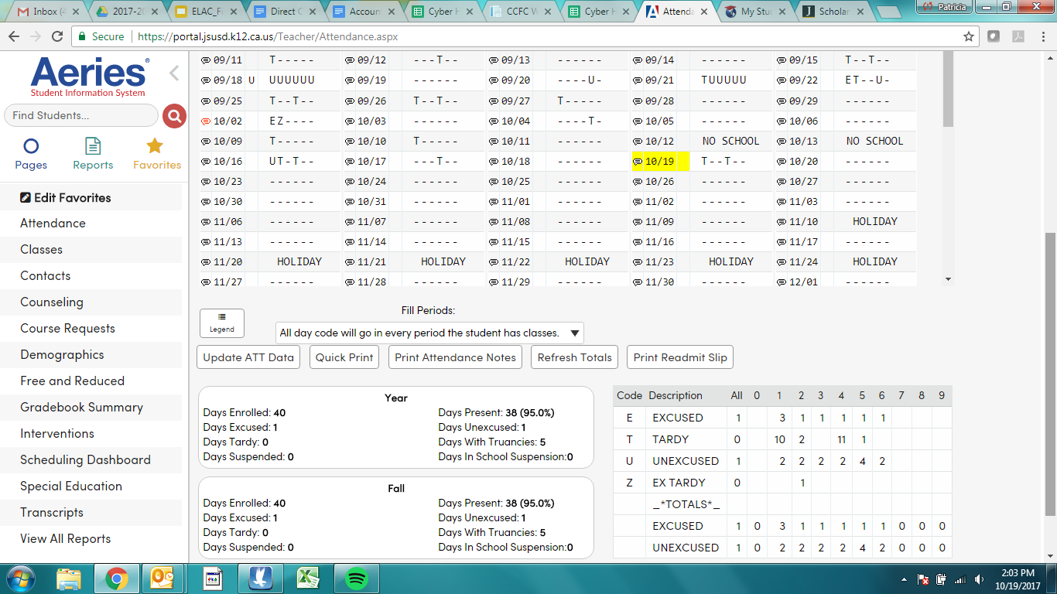
Aeries

Slide 17
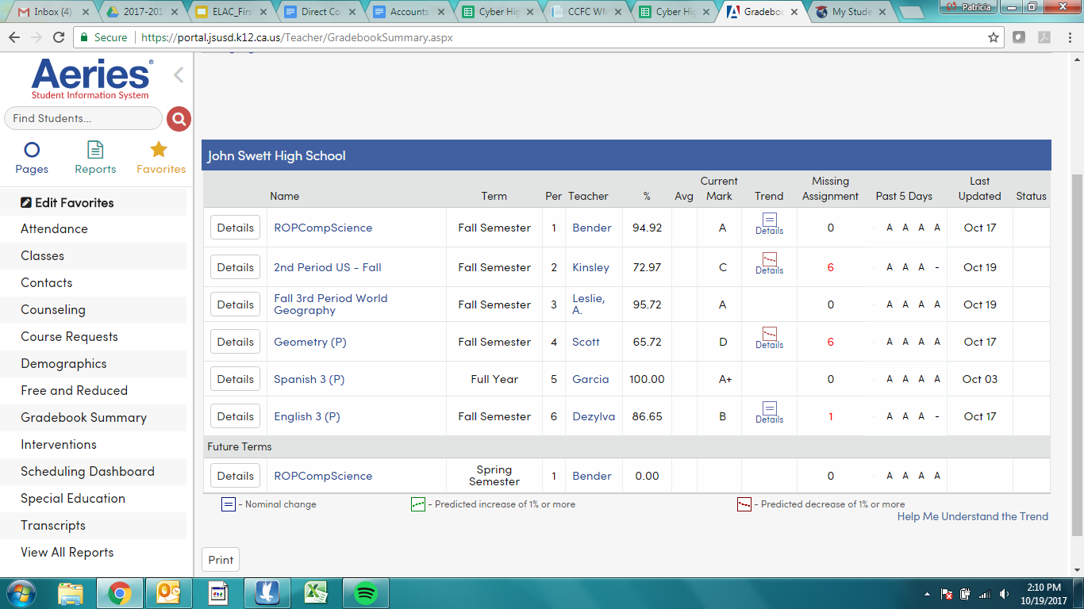
Aeries

Slide 18
JSHS: What to keep in mind this semester...
JSHS students begin choosing courses in February for next school year
Not guaranteed
Can request additional changes at a later point
Students will choose classes in their English classes
Spring term class changes
January 15th-January 27th - student requested changes
Ms. Murillo calling home for Seniors with academic concerns
Seniors:
Cap and gown ordering, contact Ms. Castillo for questions: ccastillo@jsusd.org
Graduation ceremony - Admin can answer your questions about this
Graduation concerns - will they be eligible?
Community college process
4-year students: What to expect this term
Local scholarships

Slide 19
Grade Reports - JSHS

Slide 20
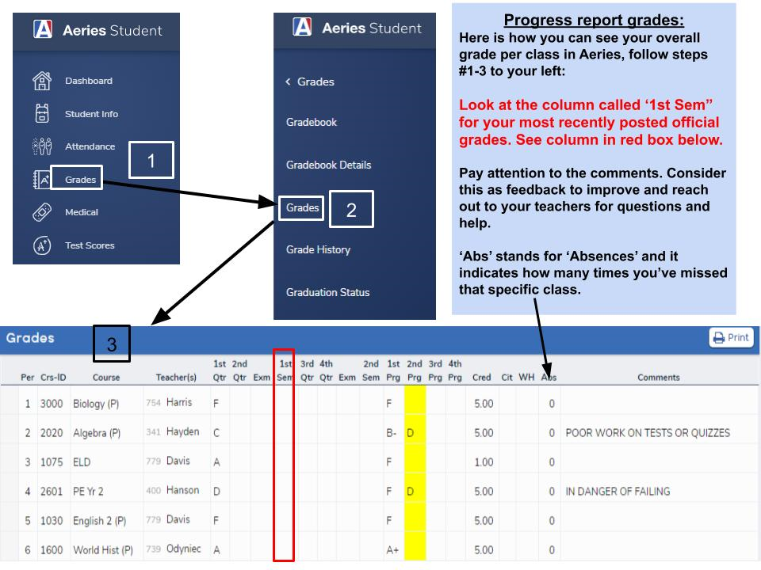
JSHS

Slide 21
Tips to be engaged….
Have a designated homework spot at home
Ensure the students have all the tools they need to be successful (computer, internet, etc)
Check grades often
Reach out to teachers for support
How can you do this if no one at home speaks English?
Teacher office hours
Cram and Cocoa (JSHS

Slide 22
Immigrants Rising….
Free resources such as legal support, scholarships, DACA, going to college, mental health, and much more!
Contact: 650-273-7204 - Estefania Hermosillo

Slide 23
Distance Learning Spring 2021
Need a computer/wifi?
Communication with teachers is important!
Any changes to the current Distance Learning schedule? Admin will address this for their schools
Questions? Comments?

Slide 24
¿Questions?
¿Questions or comments about today’s workshop?
Need help?

